Slide 1
Pictures
Blockbusters
Music
Pictures
General Knowledge

Slide 2
/12
Pictures

Slide 3
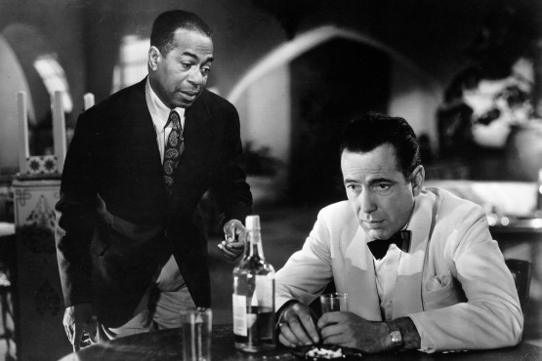
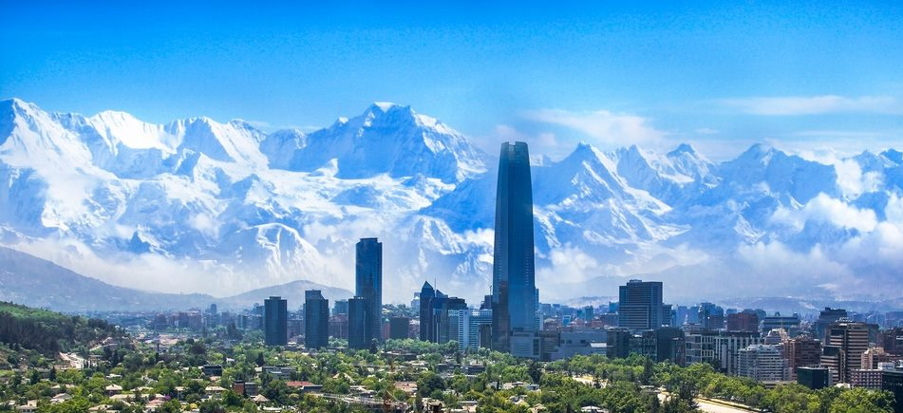
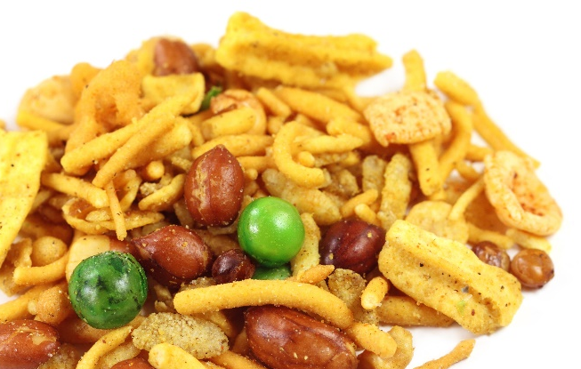
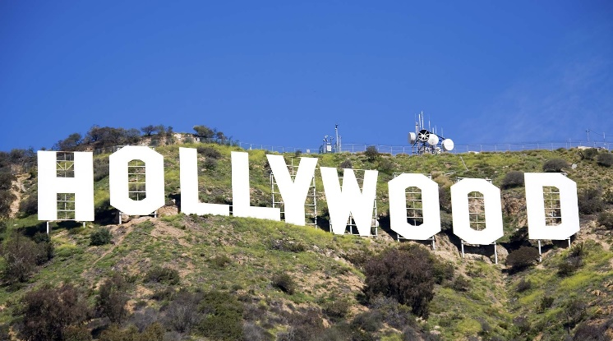
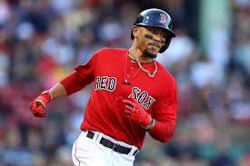
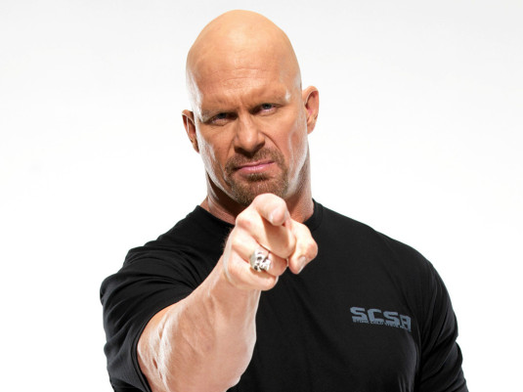
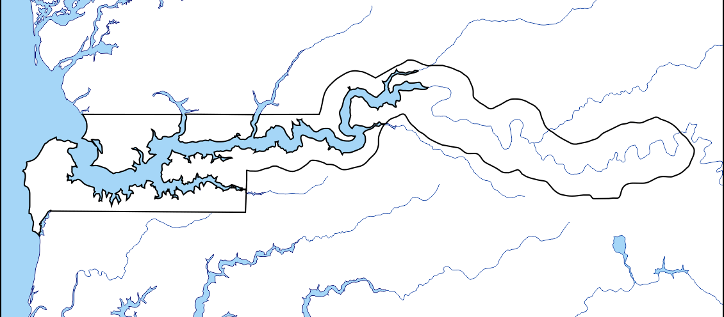
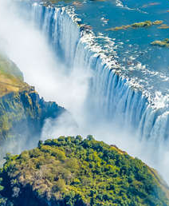
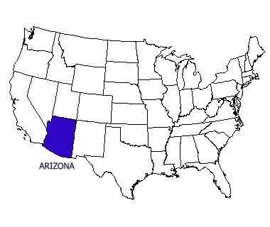
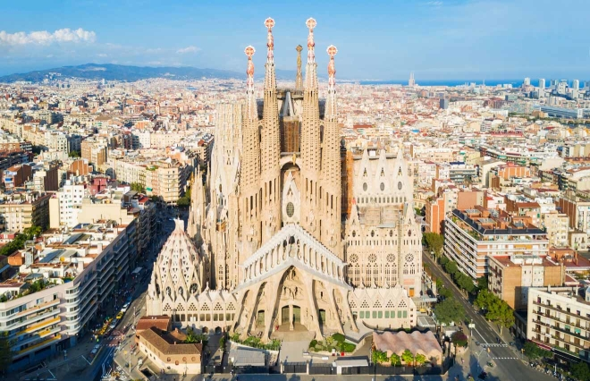
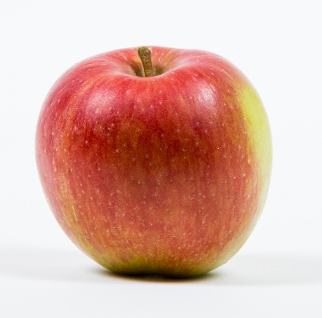
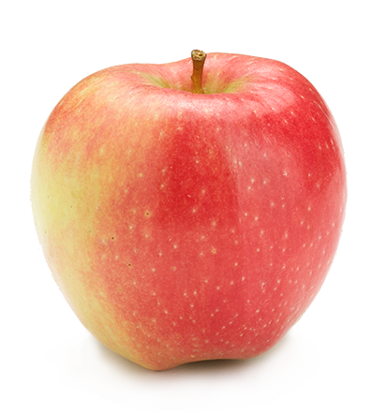
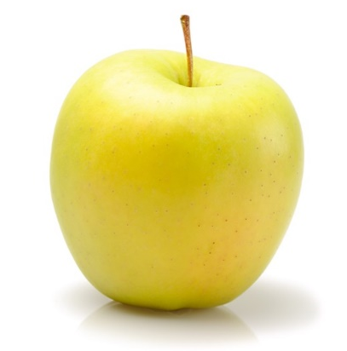
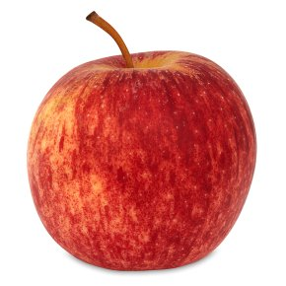
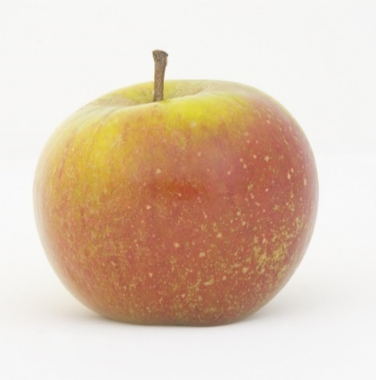
2
1
2
2
3
3
3
4
4
4
6
6
5
6
5
5
9
9
10
7
10
11
12
8
11

Slide 4
/10
Blockbusters

Slide 5
1
DTD
A simple activity which is a revealing journey of the pen.

Slide 6
2
R
Colony of penguins.

Slide 7
3
BB
Athlete who still holds the Olympic record, having competed in 1968 Olympics.

Slide 8
4
SC
The central executive of the UN, consisting of the Great Powers.

Slide 9
5
F
Cobbled together.
Also a sweet.

Slide 10
6
COR
One of the seven
Wonders of the
Ancient World.

Slide 11
7
N
Small drink.

Slide 12
8
THTT
The length of the M6 (miles)

Slide 13
9
CR
The person born as Harry Webb.

Slide 14
10
O
Lots and lot and lots.

Slide 15
/20
Music

Slide 17
/10
Pictures

Slide 18
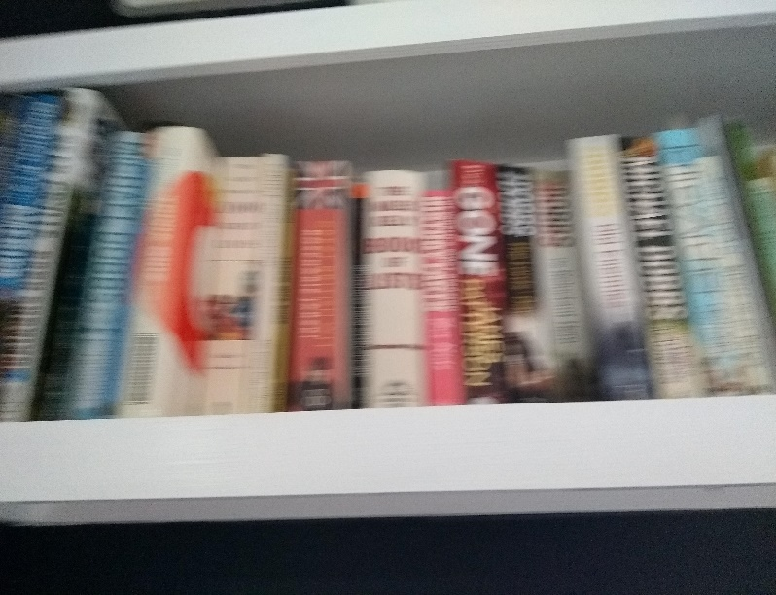
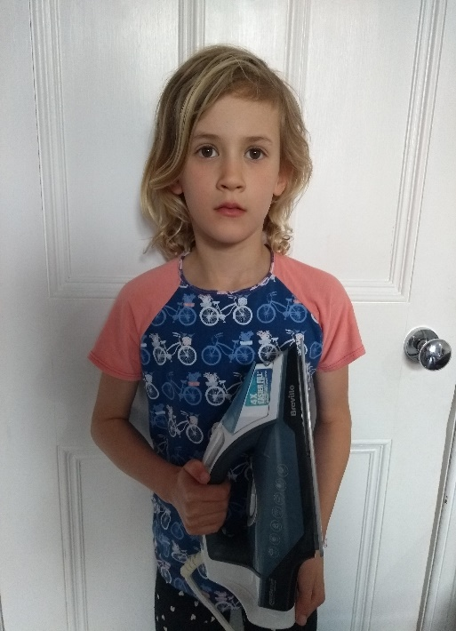
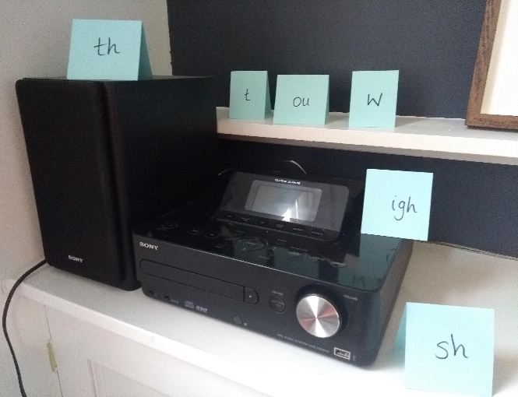
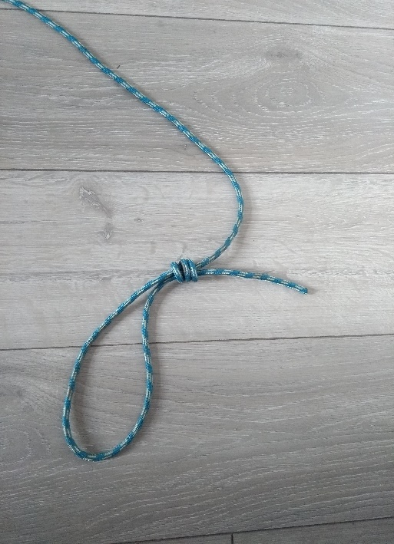
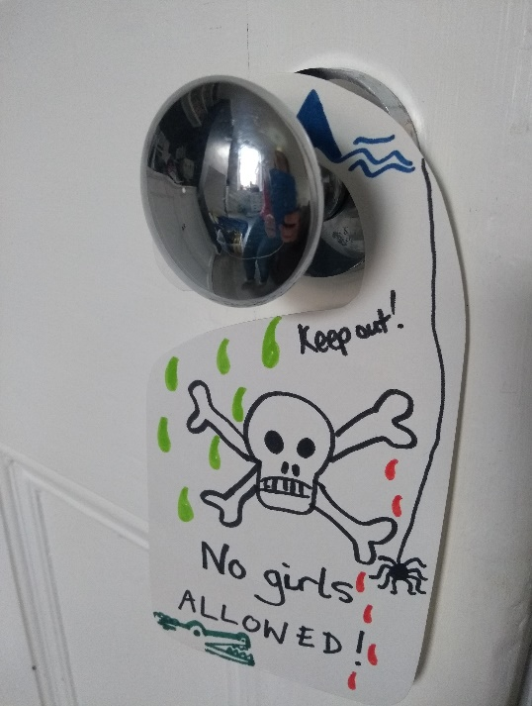
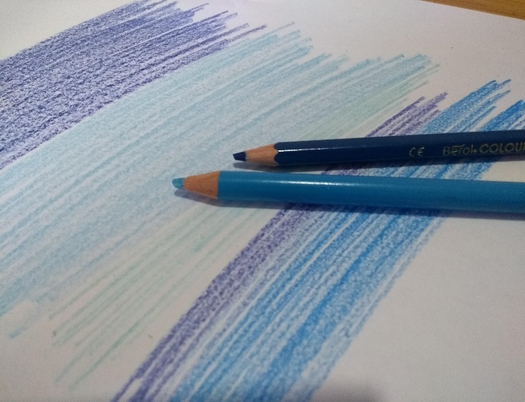
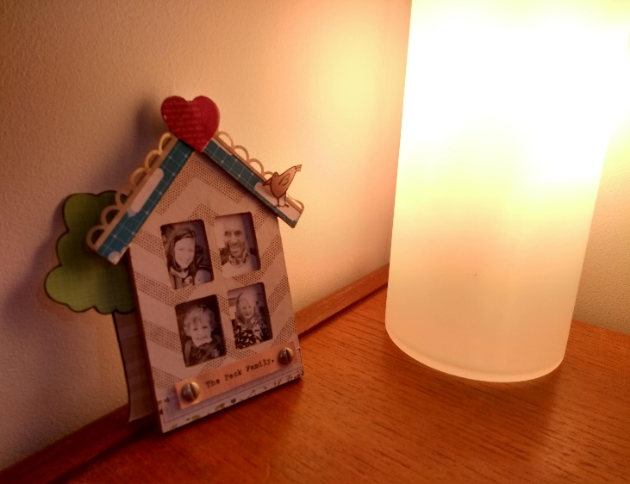
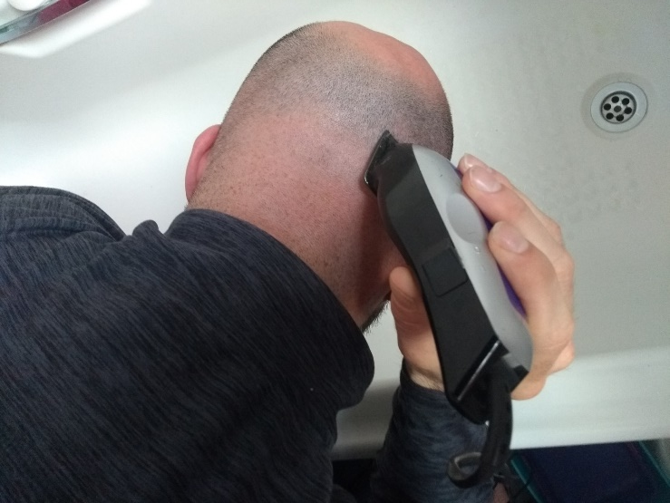
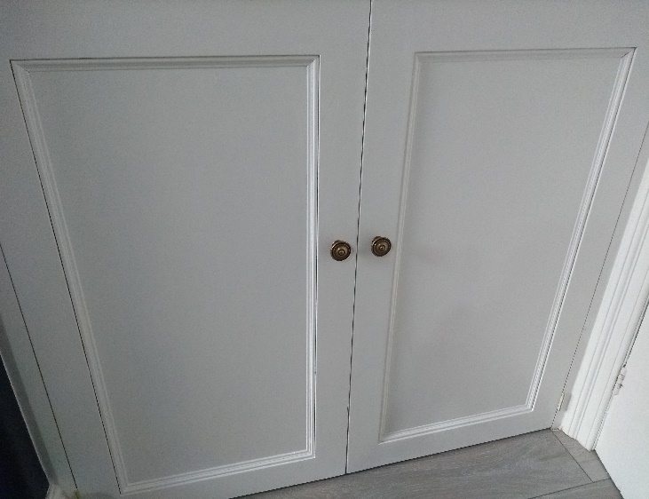
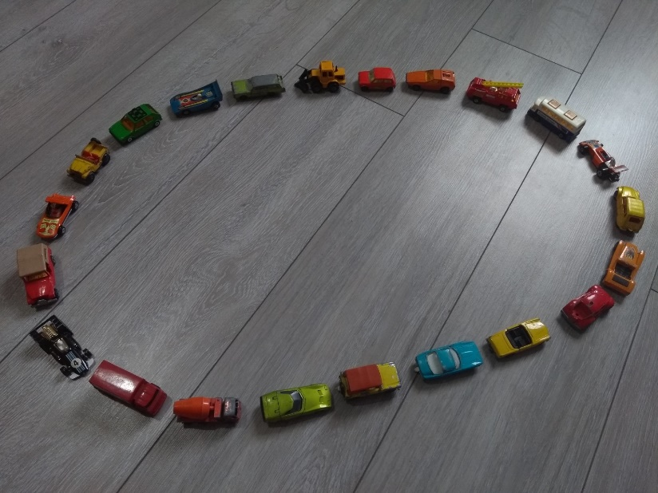
1
2
3
4
5
6
7
8
9
10

Slide 19
/20
General
Knowledge

Slide 20
1
What is the
capital of Serbia?

Slide 21
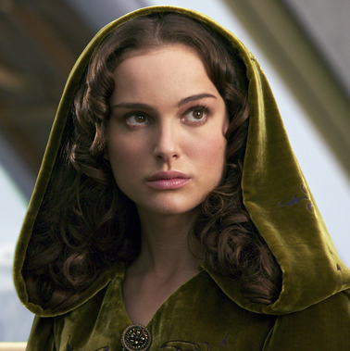
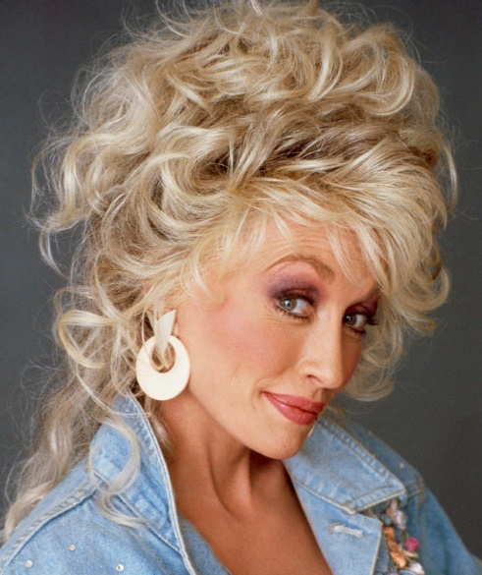
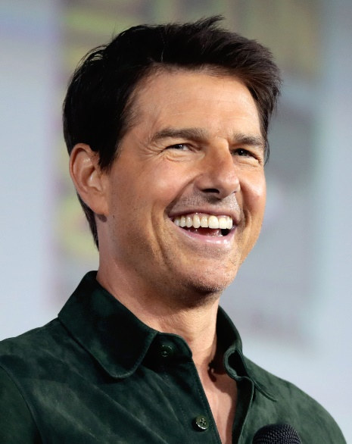
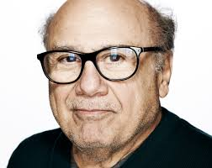
2
Which 2 celebrities
are the same height

Slide 22
3
What fruit gets its name from the Latin for ‘seeded apple’?

Slide 23
4
Which volcano erupted in AD 79 to destroy Pompeii and Herculaneum.

Slide 24
5
What word connected to disease, stems from the Venetian meaning 40 days?

Slide 25
6
What fruit is the basis of a Peach Melba sauce?

Slide 26
7
In which year did the Chernobyl reactor explode?

Slide 27
8
Johnny Weissmuller, (who played Tarzan) won five Olympic swimming golds and a bronze in which other sport?

Slide 28
9
The largest cricket stadium is in which country?

Slide 29
10
Which is larger:
9⁵ or 50,000

Slide 30
11
“The club isn't the best place to find a lover
So the bar is where I go”
Opening line of which song?

Slide 31
12
Which TV comedy is this – with all the vowels taken out.
PNLLHRS

Slide 32
13
Captain Tom predominantly served where in WW2?
Africa, Europe, Asia

Slide 33
14
Which film is this – with all the consonants taken out.
_A /_A /_A_ _

Slide 34
15
Which Arab nation has recently legalised cannabis farming?
Lebanon, Yemen, Comoros

Slide 35
16
Which country hosted the 2006 FIFA World Cup?

Slide 36
16
Which has the biggest playing court?
Badminton, Volleyball, Tennis

Slide 37
17
How many months were there between
D-Day and VE-Day?

Slide 38
19
Which 2020 film, set in the Yukon, stars Harrison Ford and
a CGI dog

Slide 39
20
“Carpe diem. Seize the day, boys. Make your lives extraordinary.”
Name the film

Slide 40
Answers

Slide 41
2
1
2
2
Sri Lanka / Casablanca
Chicago/ Santiago
3
3
3
4
4
4
Bombay / LA
Boston / Austin
6
6
5
6
5
5
Gambia / Zambia
Arizona / Barcelona
9
9
10
7
10
11
12
8
11
Granny Smith
Pink Lady
Golden Delicious
Braeburn
Gala
Cox

Slide 42
DTD
R
BB
SC
F
COR
N
THTT
CR
O
Dot To Dot
Rookery
Bob Beamon
Security Council
Fudge
Colossus of Rhodes
Nip
232
Cliff Richard
Oodles

Slide 43
Babylon
Rio
Galway
Barcelona
LA
Budapest
Bangkok
Miami
Brooklyn
Istanbul
Dover
Miami
New York
Philadelphia
Harlem
Liverpool
Vienna
Pompeii
Cairo
Jerusalem

Slide 44
1
2
3
Blur
Iron maiden
Stereophonics
4
5
6
7
Slipknot
Boyzone
Bluetones
Lighthouse Family
8
9
10
The Doors
Ed Sheeran
One Direction

Slide 45
Belgrade
Kylie & Dolly Parton
Pomegranate
Vesuvius
Quarantine
Raspberry
1986
Water Polo
India
9⁵ (59049)
Shape of you
Open all hours
Asia
La La Land
Lebanon
Germany
Tennis
11
Call of the Wild
Dead Poets Society

Slide 46
www.unlockthebox.co.uk

